Slide 2
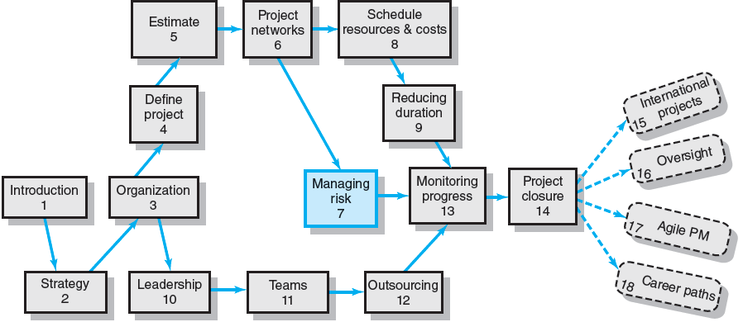
Where We Are Now

Slide 3
Risk Management Process
Risk
Uncertain or chance events that planning can not overcome or control.
Risk Management
A proactive attempt to recognize and manage internal events and external threats that affect the likelihood of a project’s success.
What can go wrong (risk event).
How to minimize the risk event’s impact (consequences).
What can be done before an event occurs (anticipation).
What to do when an event occurs (contingency plans).

Slide 4
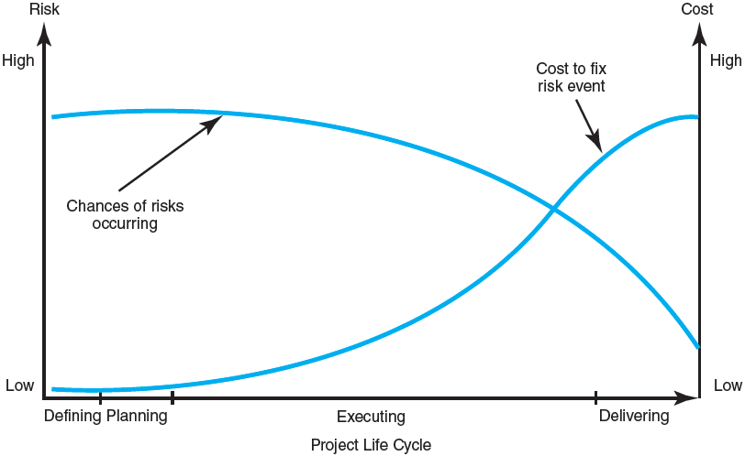
The Risk Event Graph
FIGURE 7.1

Slide 5
Risk Management’s Benefits
A proactive rather than reactive approach.
Reduces surprises and negative consequences.
Prepares the project manager to take advantage of appropriate risks.
Provides better control over the future.
Improves chances of reaching project performance objectives within budget and on time.

Slide 6
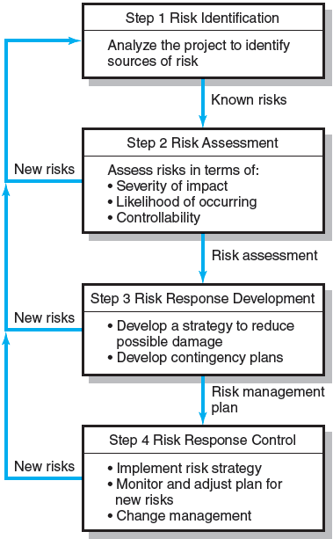
The Risk Management Process
FIGURE 7.2

Slide 7
Managing Risk
Step 1: Risk Identification
Generate a list of possible risks through brainstorming, problem identification and risk profiling.
Macro risks first, then specific events

Slide 8
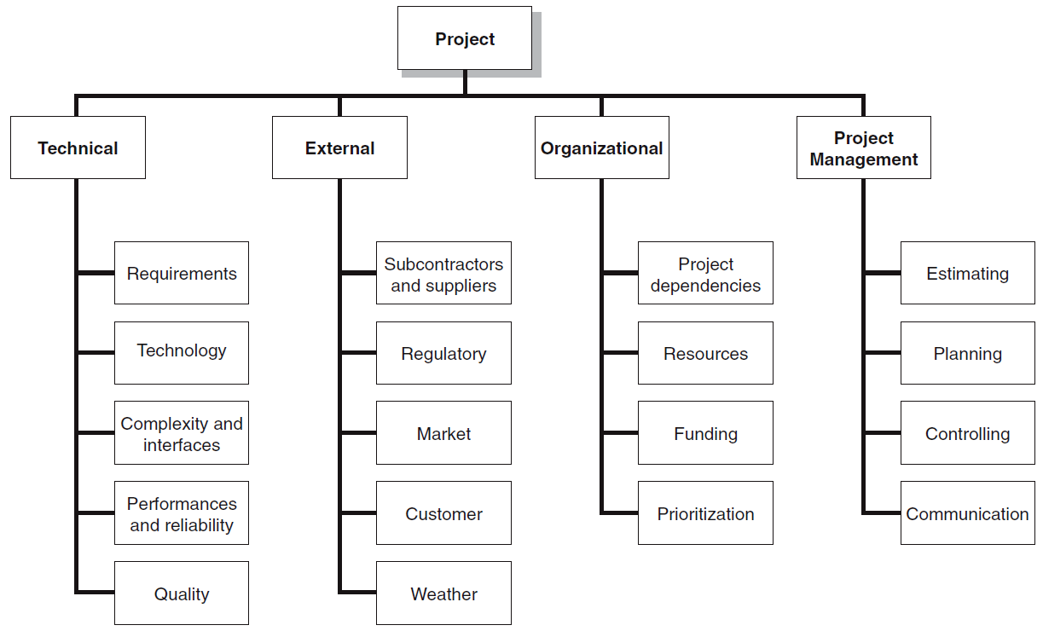
The Risk Breakdown Structure (RBS)
FIGURE 7.3

Slide 9
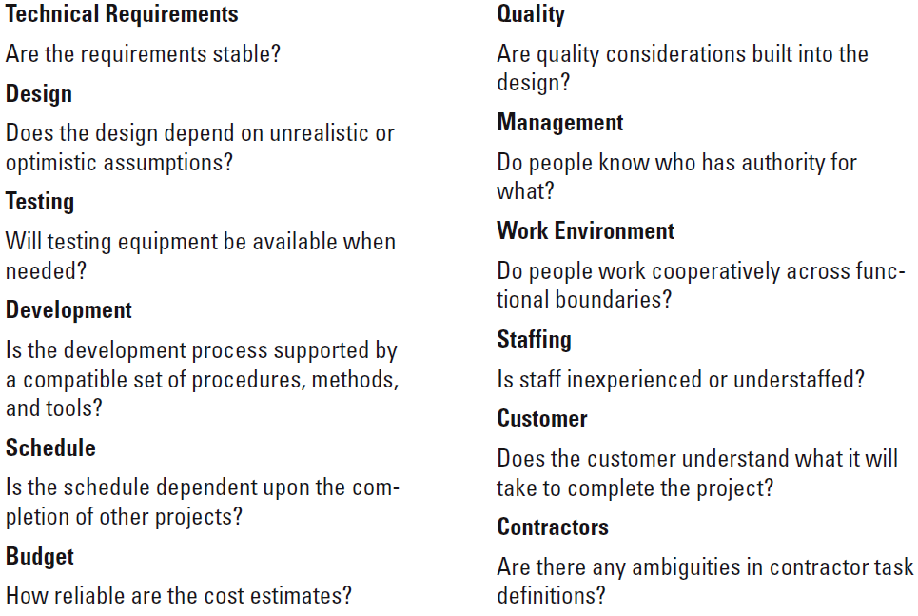
Partial Risk Profile for Product Development Project
FIGURE 7.4

Slide 10
Managing Risk
Step 2: Risk Assessment
Scenario analysis for event probability and impact
Risk assessment matrix
Failure Mode and Effects Analysis (FMEA)
Probability analysis
Decision trees, NPV, and PERT
Semiquantitative scenario analysis

Slide 11
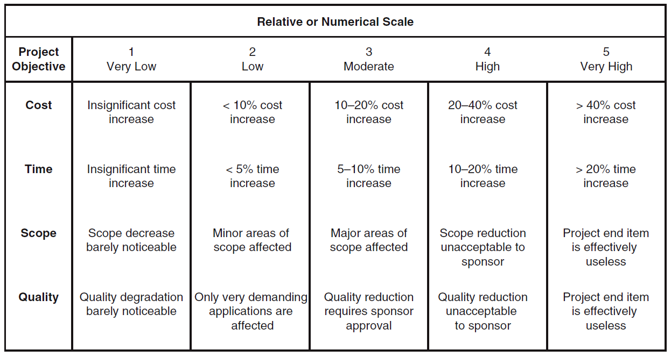
Defined Conditions for Impact Scales of a Risk on Major Project Objectives (Examples for negative impacts only)
FIGURE 7.5

Slide 12
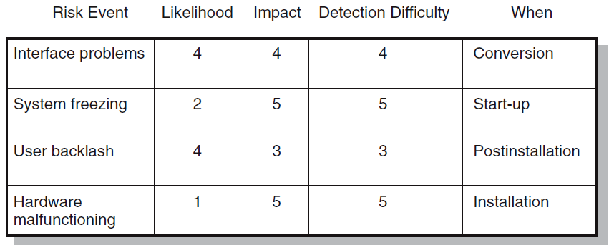
Risk Assessment Form
FIGURE 7.6

Slide 13
Risk Severity Matrix
Failure Mode and Effects Analysis (FMEA) Impact × Probability × Detection = Risk Value
 |  | User Backlash | Interface problems
 |  |  |  | System freezing
 |  |  |  | Hardware malfunc-tioning
5
4
Red zone (major risk)
Yellow zone (moderate risk)
Green zone (minor risk)
Likelihood
3
2
1
1
2
3
4
5
FIGURE 7.7
Impact

Slide 14
Managing Risk (cont’d)
Step 3: Risk Response Development
Mitigating Risk
Reducing the likelihood an adverse event will occur.
Reducing impact of adverse event.
Avoiding Risk
Changing the project plan to eliminate the risk or condition.
Transferring Risk
Paying a premium to pass the risk to another party.
Requiring Build-Own-Operate-Transfer (BOOT) provisions.
Retaining Risk
Making a conscious decision to accept the risk.

Slide 15
Contingency Planning
Contingency Plan
An alternative plan that will be used if a possible foreseen risk event actually occurs.
A plan of actions that will reduce or mitigate the negative impact (consequences) of a risk event.
Risks of Not Having a Contingency Plan
Having no plan may slow managerial response.
Decisions made under pressure can be potentially dangerous and costly.

Slide 16
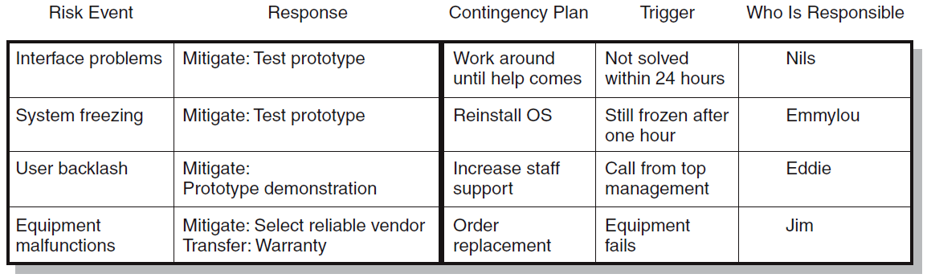
Risk Response Matrix
FIGURE 7.8

Slide 17
Risk and Contingency Planning
Technical Risks
Backup strategies if chosen technology fails.
Assessing whether technical uncertainties can be resolved.
Schedule Risks
Use of slack increases the risk of a late project finish.
Imposed duration dates (absolute project finish date)
Compression of project schedules due to a shortened project duration date.

Slide 18
Risk and Contingency Planning (cont’d)
Costs Risks
Time/cost dependency links: costs increase when problems take longer to solve than expected.
Price protection risks (a rise in input costs) increase if the duration of a project is increased.
Funding Risks
Changes in the supply of funds for the project can dramatically affect the likelihood of implementation or successful completion of a project.

Slide 19
Opportunity Management Tactics
Exploit
Seeking to eliminate the uncertainty associated with an opportunity to ensure that it definitely happens.
Share
Allocating some or all of the ownership of an opportunity to another party who is best able to capture the opportunity for the benefit of the project.
Enhance
Taking action to increase the probability and/or the positive impact of an opportunity.
Accept
Being willing to take advantage of an opportunity if it occurs, but not taking action to pursue it.

Slide 20
Contingency Funding and Time Buffers
Contingency Funds
Funds to cover project risks—identified and unknown.
Size of funds reflects overall risk of a project
Budget reserves
Are linked to the identified risks of specific work packages.
Management reserves
Are large funds to be used to cover major unforeseen risks (e.g., change in project scope) of the total project.
Time Buffers
Amounts of time used to compensate for unplanned delays in the project schedule.
Severe risk, merge, noncritical, and scarce resource activities

Slide 21
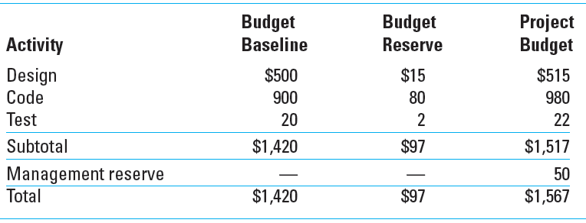
Contingency Fund Estimate ($000s)
TABLE 7.1

Slide 22
Managing Risk (cont’d)
Step 4: Risk Response Control
Risk control
Execution of the risk response strategy
Monitoring of triggering events
Initiating contingency plans
Watching for new risks
Establishing a Change Management System
Monitoring, tracking, and reporting risk
Fostering an open organization environment
Repeating risk identification/assessment exercises
Assigning and documenting responsibility for managing risk

Slide 23
Change Management Control
Sources of Change
Project scope changes
Implementation of contingency plans
Improvement changes

Slide 24
Change Control System Process
Identify proposed changes.
List expected effects of proposed changes on schedule and budget.
Review, evaluate, and approve or disapprove of changes formally.
Negotiate and resolve conflicts of change, condition, and cost.
Communicate changes to parties affected.
Assign responsibility for implementing change.
Adjust master schedule and budget.
Track all changes that are to be implemented

Slide 25
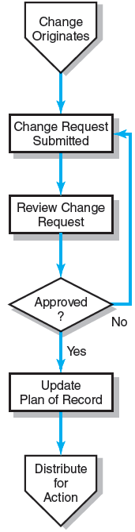
The Change Control Process
FIGURE 7.9

Slide 26
Benefits of a Change Control System
Inconsequential changes are discouraged by the formal process.
Costs of changes are maintained in a log.
Integrity of the WBS and performance measures is maintained.
Allocation and use of budget and management reserve funds are tracked.
Responsibility for implementation is clarified.
Effect of changes is visible to all parties involved.
Implementation of change is monitored.
Scope changes will be quickly reflected in baseline and performance measures.

Slide 27
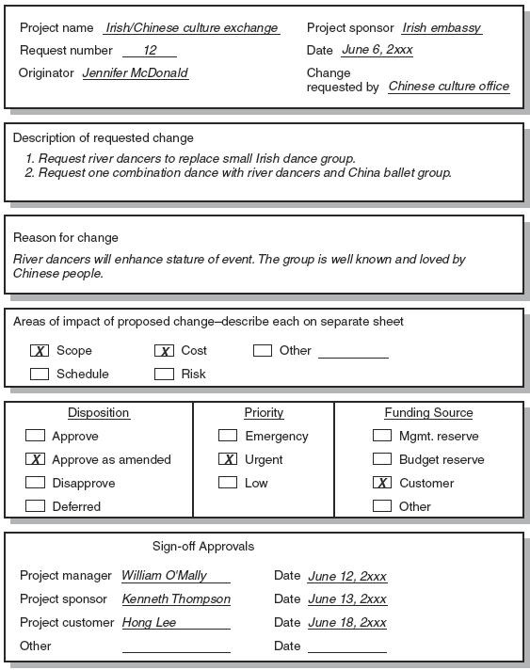
Sample Change Request
FIGURE 7.10

Slide 28
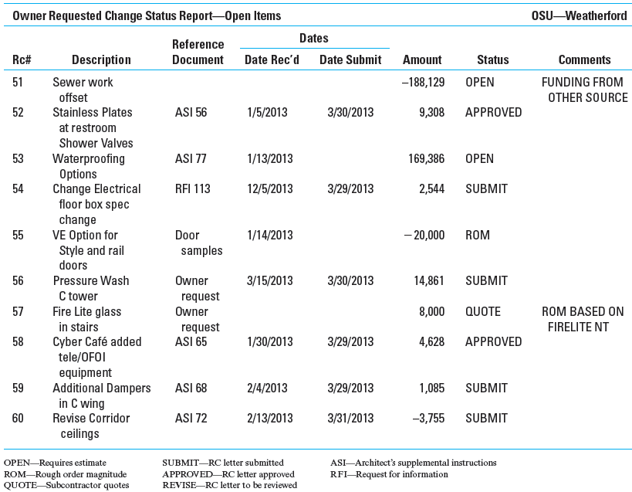
Change Request Log
FIGURE 7.11

Slide 29
Key Terms
Avoiding risk
Budget reserve
Change management system
Contingency plan
Management reserve
Mitigating risk
Opportunity
Retaining risk
Risk
Risk breakdown structure (RBS)
Risk profile
Risk register
Risk severity matrix
Scenario analysis
Time buffer
Transferring risk

Slide 30
Appendix 7.1
PERT and PERT Simulation

Slide 31
PERT—Program Evaluation Review Technique
Assumes each activity duration has a range that statistically follows a beta distribution.
Uses three time estimates for each activity: optimistic, pessimistic, and a weighted average to represent activity durations.
Knowing the weighted average and variances for each activity allows the project planner to compute the probability of meeting different project durations.

Slide 32
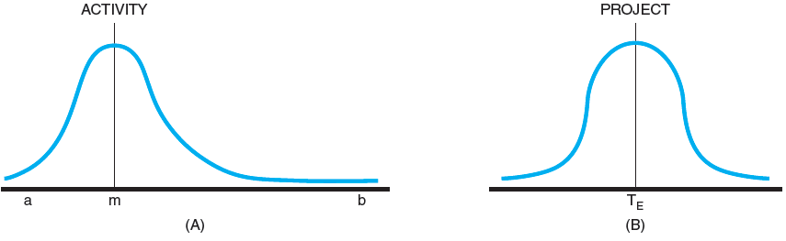
Activity and Project Frequency Distributions
FIGURE A7.1

Slide 33
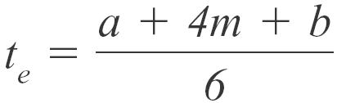
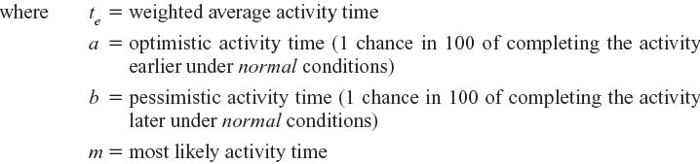
Activity Time Calculations
The weighted average activity time is computed by the following formula:
(7.1)

Slide 34
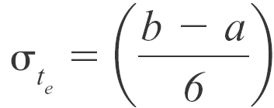

Activity Time Calculations (cont’d)
The variability in the activity time estimates is approximated by the following equations:
The standard deviation for the activity:
(7.2)
The standard deviation for the project:
(7.3)
Note the standard deviation of the activity is squared in this equation; this is also called variance. This sum includes only activities on the critical path(s) or path being reviewed.

Slide 35
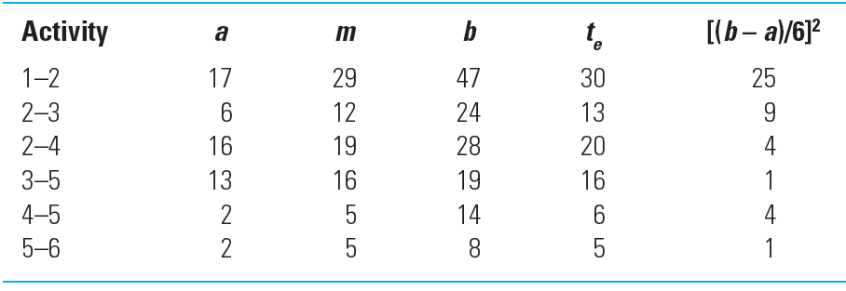
Activity Times and Variances
TABLE A7.1

Slide 36

Probability of Completing the Project
The equation below is used to compute the “Z” value found in statistical tables (Z = number of standard deviations from the mean), which, in turn, tells the probability of completing the project in the time specified.
(7.4)

Slide 37
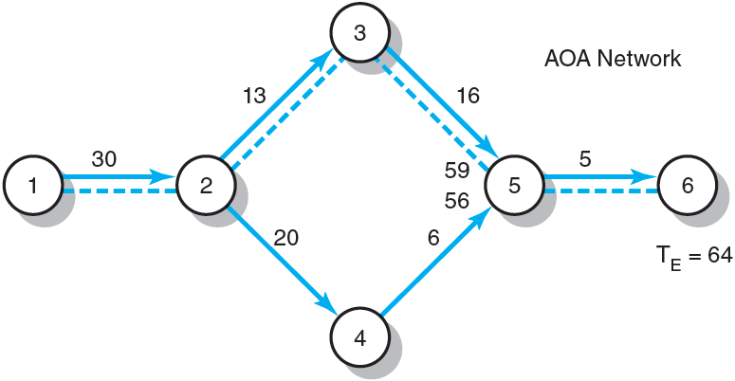
Hypothetical Network
FIGURE A7.2

Slide 38
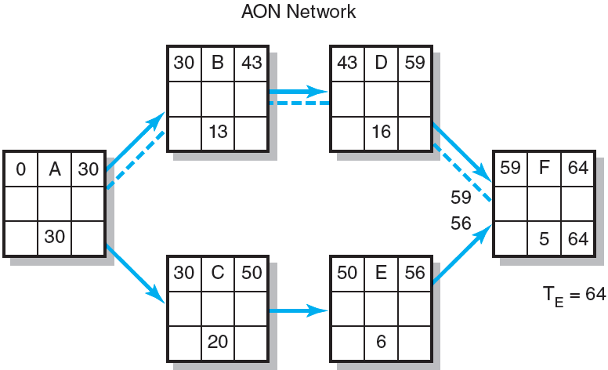
Hypothetical Network (cont’d)
FIGURE A7.2 (cont’d)

Slide 39
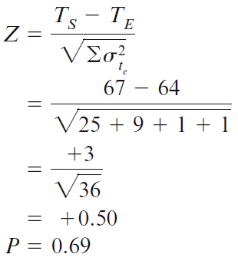
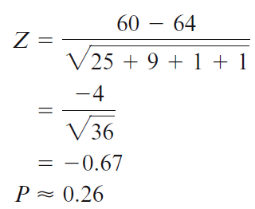
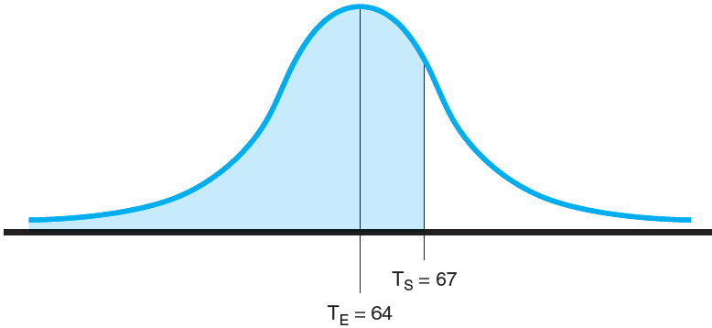
Possible Project Duration
Probability project is completed before scheduled time (T_{S}) of 67 units
Probability project is completed by the 60th unit time period (T_{S})
FIGURE A7.3

Slide 40
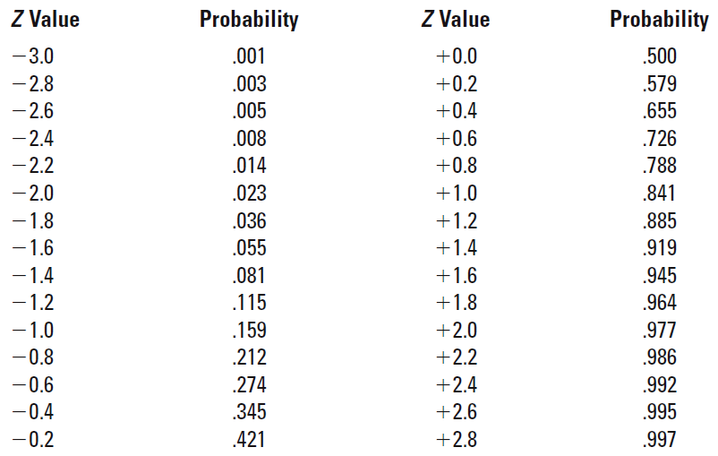
Z Values and Probabilities
TABLE A7.2

